Slide 1

Frequent Itemset Mining & Association Rules
Note to other teachers and users of these slides: We would be delighted if you found this our material useful in giving your own lectures. Feel free to use these slides verbatim, or to modify them to fit your own needs. If you make use of a significant portion of these slides in your own lecture, please include this message, or a link to our web site: http://www.mmds.org
Mining of Massive Datasets
Jure Leskovec, Anand Rajaraman, Jeff Ullman Stanford University
http://www.mmds.org

Slide 2
Association Rule Discovery
Supermarket shelf management – Market-basket model:
Goal: Identify items that are bought together by sufficiently many customers
Approach: Process the sales data collected with barcode scanners to find dependencies among items
A classic rule:
If someone buys diaper and milk, then he/she is likely to buy beer
Don’t be surprised if you find six-packs next to diapers!

Slide 3
The Market-Basket Model
A large set of items
e.g., things sold in a supermarket
A large set of baskets
Each basket is a small subset of items
e.g., the things one customer buys on one day
Want to discover association rules
People who bought {x,y,z} tend to buy {v,w}
Amazon!
Input:
Output:
Rules Discovered:
{Milk} --> {Coke}
{Diaper, Milk} --> {Beer}

Slide 4
Applications – (1)
Items = products; Baskets = sets of products someone bought in one trip to the store
Real market baskets: Chain stores keep TBs of data about what customers buy together
Tells how typical customers navigate stores, lets them position tempting items
Suggests tie-in “tricks”, e.g., run sale on diapers and raise the price of beer
Need the rule to occur frequently, or no $$’s
Amazon’s people who bought X also bought Y

Slide 5
Applications – (2)
Baskets = sentences; Items = documents containing those sentences
Items that appear together too often could represent plagiarism
Notice items do not have to be “in” baskets
Baskets = patients; Items = drugs & side-effects
Has been used to detect combinations of drugs that result in particular side-effects
But requires extension: Absence of an item needs to be observed as well as presence

Slide 6
More generally
A general many-to-many mapping (association) between two kinds of things
But we ask about connections among “items”, not “baskets”
For example:
Finding communities in graphs (e.g., Twitter)

Slide 7
Example:
Finding communities in graphs (e.g., Twitter)
Baskets = nodes; Items = outgoing neighbors
Searching for complete bipartite subgraphs K_{s,t} of a big graph
How?
View each node i as a basket B_{i} of nodes i it points to
K_{s,t} = a set Y of size t that occurs in s buckets B_{i}
Looking for K_{s,t} → set of support s and look at layer t – all frequent sets of size t
s nodes
t nodes
…
…
…
A dense 2-layer graph

Slide 8
Outline
First: Define
Frequent itemsets
Association rules:
Confidence, Support, Interestingness
Then: Algorithms for finding frequent itemsets
Finding frequent pairs
A-Priori algorithm
PCY algorithm + 2 refinements

Slide 9
Frequent Itemsets
Simplest question: Find sets of items that appear together “frequently” in baskets
Support for itemset I: Number of baskets containing all items in I
(Often expressed as a fraction of the total number of baskets)
Given a support threshold s, then sets of items that appear in at least s baskets are called frequent itemsets
Support of {Beer, Bread} = 2

Slide 10
Example: Frequent Itemsets
Items = {milk, coke, pepsi, beer, juice}
Support threshold = 3 baskets
B₁ = {m, c, b} B₂ = {m, p, j}
B₃ = {m, b} B₄ = {c, j}
B₅ = {m, p, b} B₆ = {m, c, b, j}
B₇ = {c, b, j} B₈ = {b, c}
Frequent itemsets: {m}, {c}, {b}, {j},
{m,b}
, {b,c}
, {c,j}.

Slide 11
Association Rules
Association Rules: If-then rules about the contents of baskets
{i₁, i₂,…,i_{k}} → j means: “if a basket contains all of i₁,…,i_{k} then it is likely to contain j”
In practice there are many rules, want to find significant/interesting ones!
Confidence of this association rule is the probability of j given I = {i₁,…,i_{k}}

Slide 12
Interesting Association Rules
Not all high-confidence rules are interesting
The rule X → milk may have high confidence for many itemsets X, because milk is just purchased very often (independent of X) and the confidence will be high
Interest of an association rule I → j: difference between its confidence and the fraction of baskets that contain j
Interesting rules are those with high positive or negative interest values (usually above 0.5)
Notes:
If confidence is high then interest cannot be negative

Slide 13
Example: Confidence and Interest
B₁ = {m, c, b} B₂ = {m, p, j}
B₃ = {m, b} B₄= {c, j}
B₅ = {m, p, b} B₆ = {m, c, b, j}
B₇ = {c, b, j} B₈ = {b, c}
Association rule: {m, b} →c
Confidence = 2/4 = 0.5
Interest = |0.5 – 5/8| = 1/8
Item c appears in 5/8 of the baskets
Rule is not very interesting!

Slide 14
Finding Association Rules
Problem: Find all association rules with support ≥s and confidence ≥c
Note: Support of an association rule is the support of the set of items on the left side
Hard part: Finding the frequent itemsets!
If {i₁, i₂,…, i_{k}} → j has high support and confidence, then both {i₁, i₂,…, i_{k}} and {i₁, i₂,…,i_{k}, j} will be “frequent”

Slide 15
Mining Association Rules
Step 1: Find all frequent itemsets I
(we will explain this next)
Step 2: Rule generation
For every subset A of I, generate a rule A → I \ A
Since I is frequent, A is also frequent
Variant 1: Single pass to compute the rule confidence
confidence(A,B→C,D) = support(A,B,C,D) / support(A,B)
Variant 2:
Observation: If A,B,C→D is below confidence, so is A,B→C,D
Can generate “bigger” rules from smaller ones!
Output the rules above the confidence threshold

Slide 16
Example
B₁ = {m, c, b} B₂ = {m, p, j}
B₃ = {m, c, b, n} B₄= {c, j}
B₅ = {m, p, b} B₆ = {m, c, b, j}
B₇ = {c, b, j} B₈ = {b, c}
Support threshold s = 3, confidence c = 0.75
1) Frequent itemsets:
{b,m} {b,c} {c,m} {c,j} {m,c,b}
2) Generate rules:
b→m: c=4/6 b→c: c=5/6 b,c→m: c=3/5
m→b: c=4/5 … b,m→c: c=3/4
b→c,m: c=3/6

Slide 17
Compacting the Output
To reduce the number of rules we can post-process them and only output:
Maximal frequent itemsets: No immediate superset is frequent
Gives more pruning
or
Closed itemsets: No immediate superset has the same count (> 0)
Stores not only frequent information, but exact counts

Slide 18
Example: Maximal/Closed
Frequent, but
superset BC
also frequent.
Support Maximal(s=3) Closed
A 4 No No
B 5 No Yes
C 3 No No
AB 4 Yes Yes
AC 2 No No
BC 3 Yes Yes
ABC 2 No Yes
Frequent, and
its only superset,
ABC, not freq.
Superset BC
has same count.
Its only super-
set, ABC, has
smaller count.

Slide 19
Finding Frequent Itemsets

Slide 20
Itemsets: Computation Model
Back to finding frequent itemsets
Typically, data is kept in flat files rather than in a database system:
Stored on disk
Stored basket-by-basket
Baskets are small but we have many baskets and many items
Expand baskets into pairs, triples, etc. as you read baskets
Use k nested loops to generate all sets of size k
Item
Item
Item
Item
Item
Item
Item
Item
Item
Item
Item
Item
Etc.
Items are positive integers, and boundaries between baskets are –1.
Note: We want to find frequent itemsets. To find them, we have to count them. To count them, we have to generate them.

Slide 21
Computation Model
The true cost of mining disk-resident data is usually the number of disk I/Os
In practice, association-rule algorithms read the data in passes – all baskets read in turn
We measure the cost by the number of passes an algorithm makes over the data

Slide 22
Main-Memory Bottleneck
For many frequent-itemset algorithms, main-memory is the critical resource
As we read baskets, we need to count something, e.g., occurrences of pairs of items
The number of different things we can count is limited by main memory
Swapping counts in/out is a disaster (why?)

Slide 23
Finding Frequent Pairs
The hardest problem often turns out to be finding the frequent pairs of items {i₁, i₂}
Why? Freq. pairs are common, freq. triples are rare
Why? Probability of being frequent drops exponentially with size; number of sets grows more slowly with size
Let’s first concentrate on pairs, then extend to larger sets
The approach:
We always need to generate all the itemsets
But we would only like to count (keep track) of those itemsets that in the end turn out to be frequent

Slide 24
Naïve Algorithm
Naïve approach to finding frequent pairs
Read file once, counting in main memory the occurrences of each pair:
From each basket of n items, generate its n(n-1)/2 pairs by two nested loops
Fails if (#items)² exceeds main memory
Remember: #items can be 100K (Wal-Mart) or 10B (Web pages)
Suppose 10⁵ items, counts are 4-byte integers
Number of pairs of items: 10⁵(10⁵-1)/2 = 5*10⁹
Therefore, 2*10¹⁰ (20 gigabytes) of memory needed

Slide 25
Counting Pairs in Memory
Two approaches:
Approach 1: Count all pairs using a matrix
Approach 2: Keep a table of triples [i, j, c] = “the count of the pair of items {i, j} is c.”
If integers and item ids are 4 bytes, we need approximately 12 bytes for pairs with count > 0
Plus some additional overhead for the hashtable
Note:
Approach 1 only requires 4 bytes per pair
Approach 2 uses 12 bytes per pair (but only for pairs with count > 0)

Slide 26
Comparing the 2 Approaches
4 bytes per pair
12 per
occurring pair
Triangular Matrix
Triples

Slide 27
Comparing the two approaches
Approach 1: Triangular Matrix
n = total number items
Count pair of items {i, j} only if i<j
Keep pair counts in lexicographic order:
{1,2}, {1,3},…, {1,n}, {2,3}, {2,4},…,{2,n}, {3,4},…
Pair {i, j} is at position (i –1)(n– i/2) + j –1
Total number of pairs n(n –1)/2; total bytes= 2n²
Triangular Matrix requires 4 bytes per pair
Approach 2 uses 12 bytes per occurring pair (but only for pairs with count > 0)
Beats Approach 1 if less than 1/3 of possible pairs actually occur

Slide 28
Comparing the two approaches
Approach 1: Triangular Matrix
n = total number items
Count pair of items {i, j} only if i<j
Keep pair counts in lexicographic order:
{1,2}, {1,3},…, {1,n}, {2,3}, {2,4},…,{2,n}, {3,4},…
Pair {i, j} is at position (i –1)(n– i/2) + j –1
Total number of pairs n(n –1)/2; total bytes= 2n²
Triangular Matrix requires 4 bytes per pair
Approach 2 uses 12 bytes per pair (but only for pairs with count > 0)
Beats Approach 1 if less than 1/3 of possible pairs actually occur
Problem is if we have too many items so the pairs do not fit into memory.
Can we do better?

Slide 29
A-Priori Algorithm

Slide 30
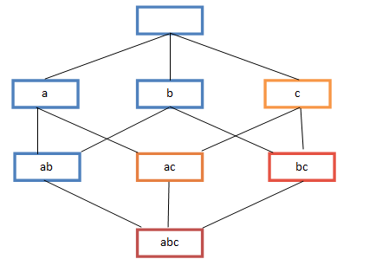
A-Priori Algorithm – (1)
A two-pass approach called A-Priori limits the need for main memory
Key idea: monotonicity
If a set of items I appears at least s times, so does every subset J of I
Contrapositive for pairs: If item i does not appear in s baskets, then no pair including i can appear in s baskets
So, how does A-Priori find freq. pairs?

Slide 31
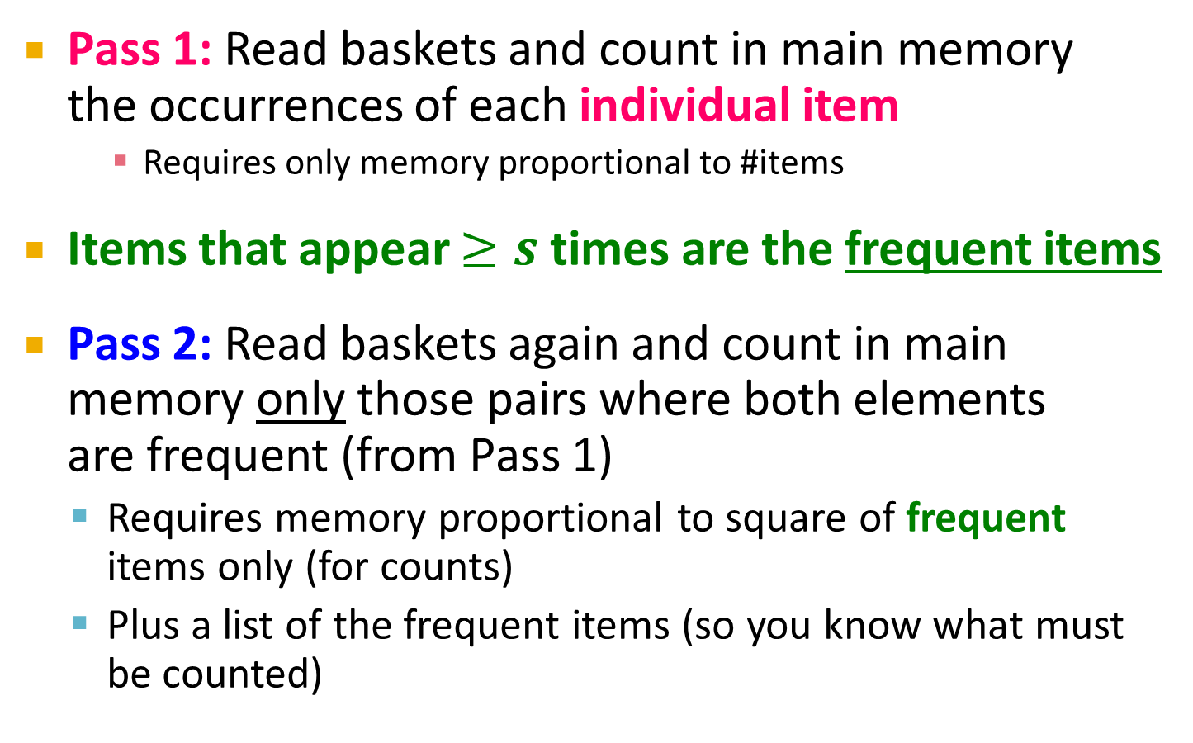
A-Priori Algorithm – (2)
Pass 1: Read baskets and count in main memory the occurrences of each individual item
Requires only memory proportional to #items
Items that appear $≥s$ times are the frequent items
Pass 2: Read baskets again and count in main memory only those pairs where both elements are frequent (from Pass 1)
Requires memory proportional to square of frequent items only (for counts)
Plus a list of the frequent items (so you know what must be counted)

Slide 32
Main-Memory: Picture of A-Priori
Item counts
Frequent items
Counts of pairs of frequent items (candidate pairs)
Main memory
Pass 1
Pass 2

Slide 33
Detail for A-Priori
You can use the triangular matrix method with n = number of frequent items
May save space compared with storing triples
Trick: re-number frequent items 1,2,… and keep a table relating new numbers to original item numbers
Item counts
Frequent items
Old item #s
Counts of pairs of frequent items
Counts of pairs of frequent items
Main memory
Pass 1
Pass 2

Slide 34
Frequent Triples, Etc.
For each k, we construct two sets of k-tuples (sets of size k):
C_{k} = candidate k-tuples = those that might be frequent sets (support > s) based on information from the pass for k–1
L_{k} = the set of truly frequent k-tuples
Count
the items
All pairs
of items
from L₁
Count
the pairs
All
items
To be
explained
Filter
Construct
Filter
Construct
C₁
L₁
C₂
L₂
C₃

Slide 35
Example
** Note here we generate new candidates by generating C_{k} from L_{k-1} and L₁. But that one can be more careful with candidate generation. For example, in C₃ we know {b,m,j} cannot be frequent since {m,j} is not frequent
Hypothetical steps of the A-Priori algorithm
C₁ = { {b} {c} {j} {m} {n} {p} }
Count the support of itemsets in C₁
Prune non-frequent: L₁ = { b, c, j, m }
Generate C₂ = { {b,c} {b,j} {b,m} {c,j} {c,m} {j,m} }
Count the support of itemsets in C₂
Prune non-frequent: L₂ = { {b,m} {b,c} {c,m} {c,j} }
Generate C₃ = { {b,c,m} {b,c,j} {b,m,j} {c,m,j} }
Count the support of itemsets in C₃
Prune non-frequent: L₃ = { {b,c,m} }
**

Slide 36
A-Priori for All Frequent Itemsets
One pass for each k (itemset size)
Needs room in main memory to count each candidate k–tuple
For typical market-basket data and reasonable support (e.g., 1%), k = 2 requires the most memory
Many possible extensions:
Association rules with intervals:
For example: Men over 65 have 2 cars
Association rules when items are in a taxonomy
Bread, Butter → FruitJam
BakedGoods, MilkProduct → PreservedGoods
Lower the support s as itemset gets bigger

Slide 37
PCY (Park-Chen-Yu) Algorithm

Slide 38
PCY (Park-Chen-Yu) Algorithm
Observation: In pass 1 of A-Priori, most memory is idle
We store only individual item counts
Can we use the idle memory to reduce memory required in pass 2?
Pass 1 of PCY: In addition to item counts, maintain a hash table with as many buckets as fit in memory
Keep a count for each bucket into which pairs of items are hashed
For each bucket just keep the count, not the actual pairs that hash to the bucket!

Slide 39
PCY Algorithm – First Pass
FOR (each basket) :
FOR (each item in the basket) :
add 1 to item’s count;
FOR (each pair of items) :
hash the pair to a bucket;
add 1 to the count for that bucket;
Few things to note:
Pairs of items need to be generated from the input file; they are not present in the file
We are not just interested in the presence of a pair, but we need to see whether it is present at least s (support) times
New in PCY

Slide 40
Observations about Buckets
Observation: If a bucket contains a frequent pair, then the bucket is surely frequent
However, even without any frequent pair, a bucket can still be frequent ☹
So, we cannot use the hash to eliminate any member (pair) of a “frequent” bucket
But, for a bucket with total count less than s, none of its pairs can be frequent ☺
Pairs that hash to this bucket can be eliminated as candidates (even if the pair consists of 2 frequent items)
Pass 2: Only count pairs that hash to frequent buckets

Slide 41
PCY Algorithm – Between Passes
Replace the buckets by a bit-vector:
1 means the bucket count exceeded the support s (call it a frequent bucket); 0 means it did not
4-byte integer counts are replaced by bits, so the bit-vector requires 1/32 of memory
Also, decide which items are frequent and list them for the second pass

Slide 42
PCY Algorithm – Pass 2
Count all pairs {i, j} that meet the conditions for being a candidate pair:
Both i and j are frequent items
The pair {i, j} hashes to a bucket whose bit in the bit vector is 1 (i.e., a frequent bucket)
Both conditions are necessary for the pair to have a chance of being frequent

Slide 43
Main-Memory: Picture of PCY
Hash
table
Item counts
Frequent items
Bitmap
Hash table for pairs
Counts of
candidate
pairs
Main memory
Pass 1
Pass 2
Notes:
Why hash table takes full space?
We want to make it as large as possible.
Why hash table bigger than bitmap?
Hash table contains counts

Slide 44
Main-Memory Details
Buckets require a few bytes each:
Note: we do not have to count past s
#buckets is O(main-memory size)
On second pass, a table of (item, item, count) triples is essential (we cannot use triangular matrix approach, why?)
Thus, hash table must eliminate approx. 2/3 of the candidate pairs for PCY to beat A-Priori
Notes:
Why? While we were able to use the triangular-matrix
method on the second pass of A-Priori if we wished, because the frequent items
could be renumbered from 1 to some m, we cannot do so for PCY. The reason
is that the pairs of frequent items that PCY lets us avoid counting are placed
randomly within the triangular matrix; they are the pairs that happen to hash
to an infrequent bucket on the ﬁrst pass. There is no known way of compacting
the matrix to avoid leaving space for the uncounted pairs.

Slide 45
Refinement: Multistage Algorithm
Limit the number of candidates to be counted
Remember: Memory is the bottleneck
Still need to generate all the itemsets but we only want to count/keep track of the ones that are frequent
Key idea: After Pass 1 of PCY, rehash only those pairs that qualify for Pass 2 of PCY
i and j are frequent, and
{i, j} hashes to a frequent bucket from Pass 1
On middle pass, fewer pairs contribute to buckets, so fewer false positives
Requires 3 passes over the data

Slide 46
Main-Memory: Multistage
First
hash table
Item counts
Freq. items
Freq. items
First hash table
Bitmap 1
Bitmap 1
Second hash table
Main memory
Bitmap 2
Counts of
candidate
pairs
Counts of
candidate
pairs
Pass 1
Pass 2
Pass 3
Hash pairs {i,j} into Hash2 iff:
i,j are frequent, {i,j} hashes to
freq. bucket in B1
Count pairs {i,j} iff:
i,j are frequent, {i,j} hashes to
freq. bucket in B1
{i,j} hashes to
freq. bucket in B2
Count items
Hash pairs {i,j}

Slide 47
Multistage – Pass 3
Count only those pairs {i, j} that satisfy these candidate pair conditions:
Both i and j are frequent items
Using the first hash function, the pair hashes to a bucket whose bit in the first bit-vector is 1
Using the second hash function, the pair hashes to a bucket whose bit in the second bit-vector is 1

Slide 48
Important Points
The two hash functions have to be independent
We need to check both hashes on the third pass
If not, we would end up counting pairs of frequent items that hashed first to an infrequent bucket but happened to hash second to a frequent bucket

Slide 49
Refinement: Multihash
Key idea: Use several independent hash tables on the first pass
Risk: Halving the number of buckets doubles the average count
We have to be sure most buckets will still not reach count s
If so, we can get a benefit like multistage, but in only 2 passes

Slide 50
Main-Memory: Multihash
First hash
table
Second
hash table
Item counts
Freq. items
First hash table
Bitmap 1
Main memory
Bitmap 2
Counts of
candidate
pairs
Counts of
candidate
pairs
Second hash table
Pass 1
Pass 2

Slide 51
PCY: Extensions
Either multistage or multihash can use more than two hash functions
In multistage, there is a point of diminishing returns, since the bit-vectors eventually consume all of main memory
For multihash, the bit-vectors occupy exactly what one PCY bitmap does, but too many hash functions makes all counts > s

Slide 52
Frequent Itemsets in < 2 Passes

Slide 53
Frequent Itemsets in < 2 Passes
A-Priori, PCY, etc., take k passes to find frequent itemsets of size k
Can we use fewer passes?
Use 2 or fewer passes for all sizes, but may miss some frequent itemsets
Random sampling
SON (Savasere, Omiecinski, and Navathe)
Toivonen (see textbook)

Slide 54
Random Sampling (1)
Take a random sample of the market baskets
Run a-priori or one of its improvements in main memory
So we don’t pay for disk I/O each time we increase the size of itemsets
Reduce support threshold proportionally to match the sample size
Copy of
sample
baskets
Main memory
Space
for
counts

Slide 55
Random Sampling (2)
Optionally, verify that the candidate pairs are truly frequent in the entire data set by a second pass (avoid false positives)
But you don’t catch sets frequent in the whole but not in the sample
Smaller threshold, e.g., s/125, helps catch more truly frequent itemsets
But requires more space

Slide 56
SON Algorithm – (1)
Repeatedly read small subsets of the baskets into main memory and run an in-memory algorithm to find all frequent itemsets
Note: we are not sampling, but processing the entire file in memory-sized chunks
An itemset becomes a candidate if it is found to be frequent in any one or more subsets of the baskets.

Slide 57
SON Algorithm – (2)
On a second pass, count all the candidate itemsets and determine which are frequent in the entire set
Key “monotonicity” idea: an itemset cannot be frequent in the entire set of baskets unless it is frequent in at least one subset.

Slide 58
SON – Distributed Version
SON lends itself to distributed data mining
Baskets distributed among many nodes
Compute frequent itemsets at each node
Distribute candidates to all nodes
Accumulate the counts of all candidates

Slide 59
SON: Map/Reduce
Phase 1: Find candidate itemsets
Map?
Reduce?
Phase 2: Find true frequent itemsets
Map?
Reduce?

